Slide 1
Introducing Wonders
Notes:
Introducing Wonders
Welcome families and explain that after a careful review process, Wonders was selected as the reading and language arts program.

Slide 2
What Is Wonders?
Wonders is a comprehensive, research-based English language arts program that supports children in Grades K–6 to build a strong foundation in literacy.
Notes:
What Is Wonders?
Click to reveal a description of Wonders. Explain that Wonders is a comprehensive English language arts program for children in Grades K–6.

Slide 3
Why Wonders?
Support for close reading, citing evidence, writing to sources
Daily opportunities for academic conversations and collaboration
Technology to support learning at school and home
McGraw-Hill Education
Notes:
Why Wonders?
Explain key reasons for the decision, such as how Wonders
Supports students to engage in close readings of complex texts, identify and cite text evidence, and write to sources.
Provides daily opportunities for students to use academic language while collaborating and conversing with peers.
Integrates technology to facilitate learning.

Slide 4
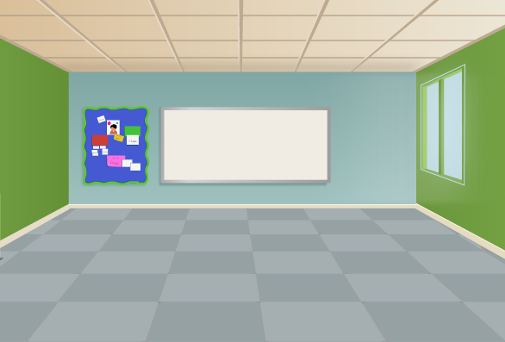
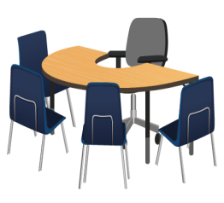
Wonders at School
Notes:
Wonders at School
Explain that the Wonders classroom offers opportunities for whole-group lessons, small-group teacher-led instruction, and independent practice. Use slides 5–9 to highlight some key features of a typical Wonders classroom.

Slide 5
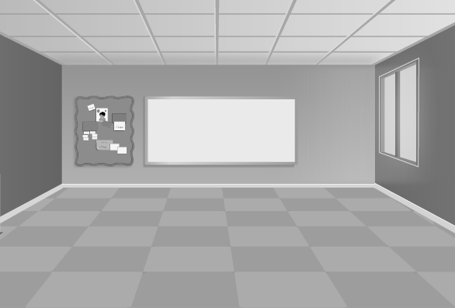
Wonders at School: Whole Group
Whole Group Instruction
Daily whole group lessons provide teacher-guided support in language and vocabulary, close reading, and writing to sources.
Notes:
Wonders at School: Whole Group
Point out that daily whole-group lessons engage children in standards-aligned lessons that support children to build language and vocabulary, develop close reading skills, and learn to write analytically. Each unit of instruction focuses on high-interest themes with lessons that help to introduce and reinforce skills and strategies.

Slide 6
Wonders at School: Small Group
Small Group Instruction
Students benefit from targeted support during teacher-guided small-group lessons.
Notes:
Wonders at School: Small Group
Explain that a Wonders classroom will include an area for small-group instruction. The teacher will use data to group students and plan targeted lessons.

Slide 7
Wonders at School: Independent Practice
Independent Practice
During small-group time, students practice skills and extend learning by engaging in workstation activities, independent reading, or independent writing.
Notes:
Wonders at School: Independent Practice
Explain that while students are with the teacher for small-group instruction, other students will practice skills and extended their learning independently. Children might work in groups, pairs, or on their own to complete activities at workstations or online. Children might also extend their learning by independently reading leveled readers or trade books from the Wonders library.

Slide 8
Wonders at School: Digital Resources
Digital Resources
Students can log on to ConnectED Student Workspace to complete digital assignments and practice skills with educational games.
Notes:
Wonders at School: Digital Resources
Share that Wonders includes digital resources. Explain the extent to which your school or district will be incorporating digital components such as
eBooks
Online assignments
Online games

Slide 9
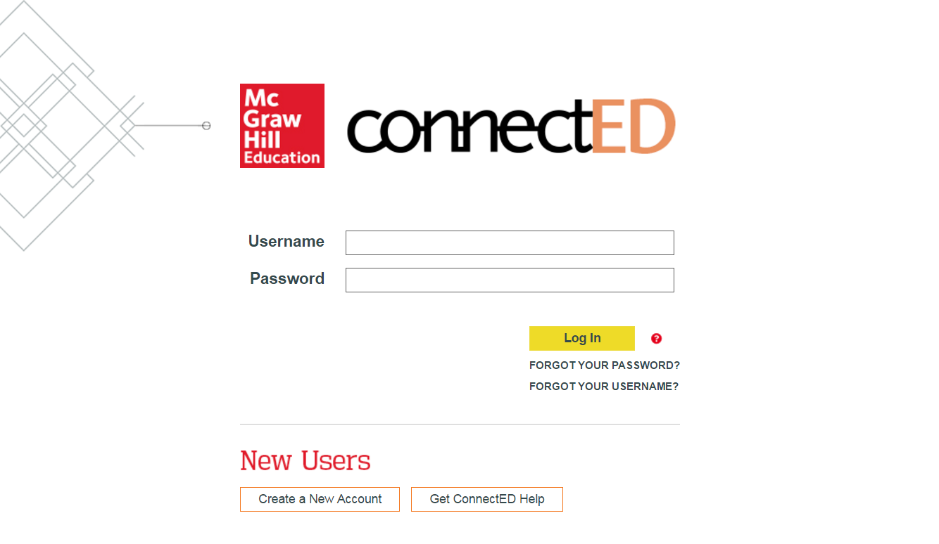
Wonders at Home
http://connected.mcgraw-hill.com
Notes:
Wonders at Home
Share that children can access their digital resources and games from any computer with an Internet connection by going to http://connected.mcgraw-hill.com and signing in with the username and password provided to them by their teacher.

Slide 10
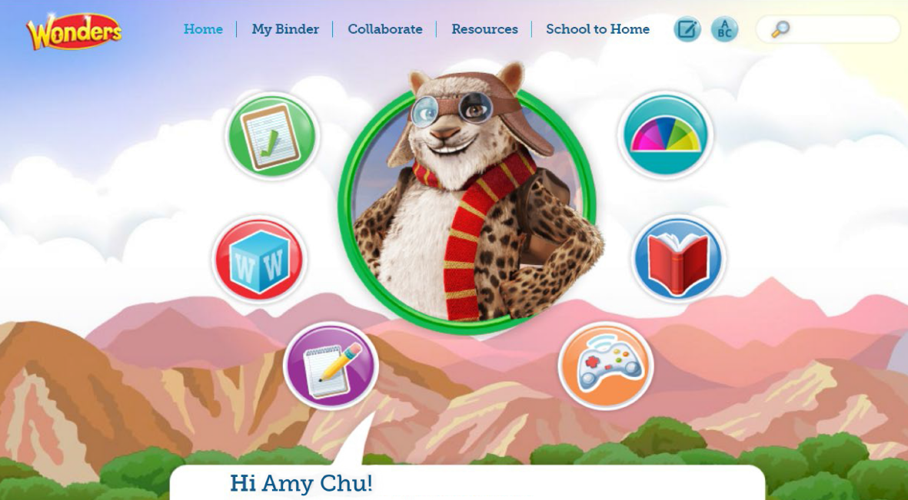
Wonders at Home
http://connected.mcgraw-hill.com
Notes:
Wonders at Home
Show the ConnectED Student Workspace home page. Click to reveal what the Student Workspace has to offer, including
To Do: Children can go here to see their assignments from the teacher.
Words to Know: Children practice their individual list of weekly vocabulary words.
Write: In the Writer’s Workshop, older children will work on weekly writing assignments, while younger children work on handwriting skills.
Games: Online games provide children with skills practice and teachers with data they can use to plan targeted classroom instruction.
Read: Children can access the digital books taught in that week’s lessons.
Adaptive Learning: If the school or district uses Wonders for English Learners or WonderWorks, point out the Adaptive Learning games provide skills practice, adjusting and customizing based on how children perform.

Slide 11
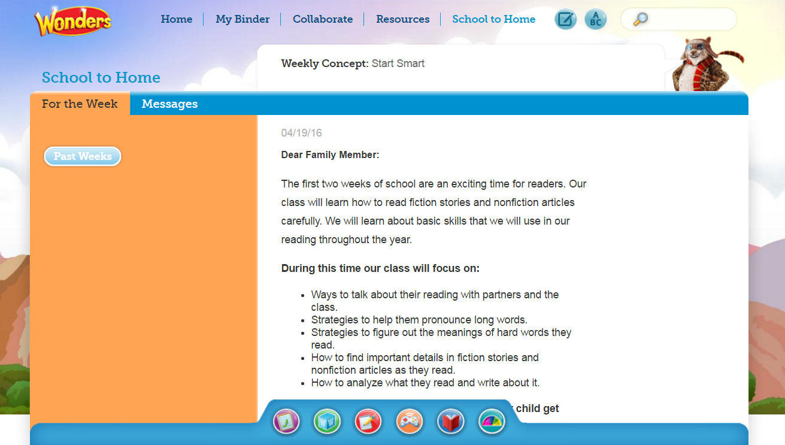
School to Home | Weekly Letters
http://connected.mcgraw-hill.com
Notes:
School to Home | Weekly Letters
Explain that families can also log in to the ConnectED Student Workspace to learn what their children are experiencing during that week of instruction. These letters also include printable activities to reinforce what is being taught and a weekly spelling list. Click to point out the School to Home link at the top and the For the Week tab that explains the week’s learning objectives.

Slide 12
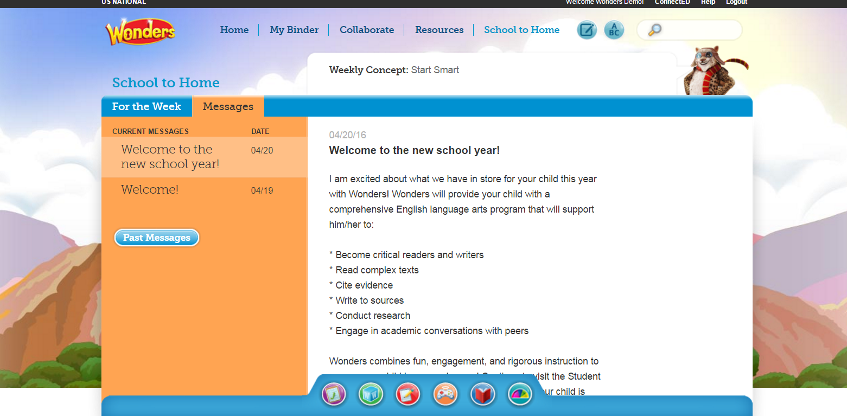
School to Home | Teacher Messages
http://connected.mcgraw-hill.com
Notes:
School to Home | Teacher Messages
Point out that families can click the Messages tab to see any communications from the teacher.

Slide 13
Notes:
Conclusion
Conclude by sharing your excitement for the program.

